Slide 1
Employee Data Analysis using Excel
STUDENT NAME:MUTHARASI.K
REGISTER NO:122204450
NAAN MUDHALVAN ID:564CFEEF4649327BA54436095DCE7A52
DEPARTMENT:B.COM(CORPORATE SECRETARYSHIP)
COLLEGE:AVICHI COLLEGE OF ARTS AND SCIENCE

Slide 2
PROJECT TITLE
Employee Performance Analysis using Excel

Slide 3


AGENDA
Problem Statement
Project Overview
End Users
Our Solution and Proposition
Dataset Description
Modelling Approach
Results and Discussion
Conclusion
3/21/2024 Annual Review

Slide 4

PROBLEM STATEMENT
A scientific research organization seeks to analyze soil erosion patterns across various regions. Using Excel, the team needs to clean, organize, and visualize data related to soil erosion rates, weather conditions, and land use. The goal is to identify trends, correlations, and potential risk areas to inform decision-making and policy development. Excel functions, such as pivot tables and charts, will be employed to support data-driven insights and recommendations.

Slide 5

PROJECT OVERVIEW
The project aims to analyze employee performance using key metrics such as productivity, quality of work, attendance, and peer feedback. It involves collecting data, identifying trends, and generating insights to improve overall performance, inform decision-making, and support strategic workforce planning for enhanced efficiency and employee development.
.

Slide 6

WHO ARE THE END USERS?
The end users of employee performance analysis using Excel are:- HR Managers: to track and evaluate employee performance, identify training needs, and make informed decisions.- Supervisors: to monitor team performance, set goals, and provide feedback.- Employees: to view their own performance metrics, set goals, and track progress.- Business Leaders: to make data-driven decisions on promotions, bonuses, and resource allocation.- Analysts: to analyze trends, identify areas for improvement, and create reports.These users can leverage Excel to streamline performance analysis and drive business growth.

Slide 7

OUR SOLUTION AND ITS VALUE PROPOSITION
Here's a possible solution and value proposition for employee performance analysis using Excel:*Solution:* "ExcelPerform" - A comprehensive employee performance analysis toolkit in Excel, featuring:1. Automated data import and integration2. Customizable performance metrics and dashboards3. Real-time tracking and reporting4. Advanced analytics and visualization5. Actionable insights for data-driven

Slide 8
Dataset Description
"Employee Performance Dataset:- Employee ID- Name- Department- Job Title- Performance Metrics (Sales, Productivity, Quality)- Ratings (1-5)- Feedback- Goals- Training Needs- Promotion EligibilityThis dataset enables analysis of individual and team performance, identification of training needs, and data-driven decisions for promotions and development."

Slide 9

THE "WOW" IN OUR SOLUTION
Here's the "WOW" factor in your solution for employee performance analysis using Excel:*WOW Factors:*1. *Automated Performance Tracking*: Effortlessly monitor employee performance in real-time, eliminating manual data entry and reducing errors.2. *Customizable Dashboards*: Create tailored views for HR, managers, and employees, ensuring relevant insights and actionable data.3. *Data-Driven Decisions*: Make informed decisions on promotions, training, and development with accurate and up-to-date performance metrics.4. *Employee Engagement*: Empower employees to take ownership of their growth with transparent feedback, goal-setting, and progress tracking.
3/21/2024 Annual Review
9

Slide 10
MODELLING
"Create a comprehensive model in Excel to analyze employee performance, featuring:- Data Input Sheet for employee information and performance metrics- Performance Dashboard for real-time tracking and visualization- Analysis Sheet for calculating ratings, feedback, and development needs- Reporting Sheet for summarized insights and recommendationsEnable data-driven decisions and improved employee growth."
10

Slide 11
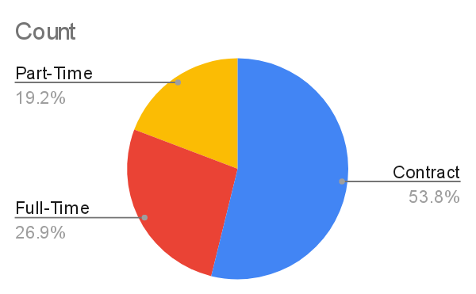

Slide 12
RESULTS
Here's a potential result of employee performance analysis using Excel:*Employee Performance Analysis Results*- *Top Performers*: Identify top 10% of employees with highest ratings and exceptional performance metrics.- *Development Needs*: Flag employees requiring training or improvement in specific areas.- *Performance Trends*: Visualize department-wise or team-wise performance trends over time.- *Goal Achievement*: Track progress towards individual and team goals.- *Feedback and Coaching*: Provide actionable insights for managers to coach and develop employees.
12

Slide 13
conclusion
Here's a potential conclusion for employee performance analysis using Excel:"By leveraging Excel for employee performance analysis, organizations can:- Streamline performance tracking and reporting- Gain actionable insights for data-driven decisions- Identify top performers and development needs- Enhance employee engagement and growth- Drive business growth through optimized talent management

